Slide 1
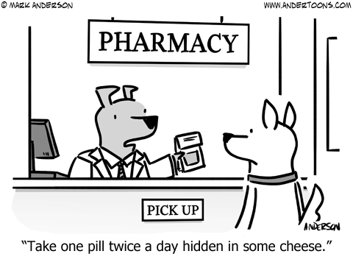
Pharmacy Management System
M Gnana Ganesh

Slide 2

Under the guidance of:
Dr Suresh S
DBMS Subject Handling faculty
School of computing

Slide 3
Abstract
Pharmacies are essential component of healthcare in the India and handle the function of selling medical drugs. Even though the pharmacies do not seem different than any other shop, their functioning is very different due to various laws regarding drugs. For example, most of the drugs available in a pharmacy cannot be purchased without a prescription. Even with a signed prescription, there is a limit on the quantity that can be purchased. Additionally, pharmacist can do a background check on customer’s medical history to ensure that they are not involved in drug abuse. In addition, there are other laws on the operations of pharmacy like requirement for safe disposal of expired medicine and requirement of license for employees that mix/prepare the drugs. Thus, preparing a Database Management System for a pharmacy not only requires study of how things are handled from a customer or employee point of view but also the relevant laws. With this project, our aim was to develop a comprehensive system that could deal with challenges faced in day to day operation of a modern pharmacy. We studied the relevant laws and prepared a system that complies with the law.

Slide 4
ER Diagram
P_id
P_Name
C_Name
Product
Customer
Buys
Supplies
C_mail
S_name
Supplier
C_id
S_mail
S_id

Slide 5
Thank You

